Slide 1

UNIVERSITY OF MESSINA
Department
Cognitive Science and Theory of Communication – LM-55
Course Title
SOCIAL SEMIOTICS
Teacher
Maria Rita Bartolomei
Mail: mabartolomei@unime.it

Slide 2

SOCIAL SEMIOTICS
Semiotic function
is the ability to create symbols – language, picture, or gesture – to represent actions or objects mentally
is based on the use of signs and symbols which have distinct signifieds and signifiers
is one of the most important human abilities

Slide 3
SOCIAL SEMIOTICS
Sign
the union of a signifier and a signified
Signifier
the observable form of the sign, such as a sound, a word or a colour
create a communication; the sensory impression of the sign
Signified
the concept that a signifier refers to
it depends on who you are and where you are

Slide 4



SOCIAL SEMIOTICS
Symbol
a sign, shape, person or object which is used to represent something else
something which is used to represent a quality or idea

Slide 5
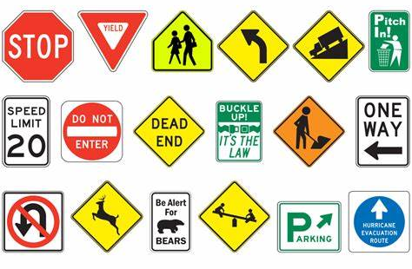
SOCIAL SEMIOTICS
Traffic signs

Slide 6

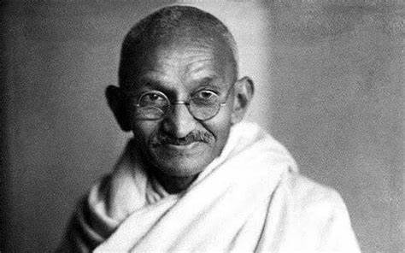

SOCIAL SEMIOTICS
Even a person can have a symbolic meaning

Slide 7

SOCIAL SEMIOTICS
The symbol has a strong meaning potential
Red colour
danger, passion, murder

Slide 8



SOCIAL SEMIOTICS
Blood, murder

Slide 9
SOCIAL SEMIOTICS
The term “meaning potential”
focuses on meanings which have already been introduced into society
The term “affordance”
also brings in meanings which have not been recognized,
which are waiting to be discovered
The meaning potential – affordance of a semiotic resource
consists of all their past, present and future uses

Slide 10

SOCIAL SEMIOTICS
Semiotic rules
Symbol
the relation between signifier and signified
is arbitrary, wholly conventional

Slide 11
SOCIAL SEMIOTICS
Semiotic function
Jean Piaget elaborated the theory of semiotic function
for early children to early elementary age students
The so called pre-operational stage begins around
age two and lasts until approximately age seven
During this period, children cannot use logic or transform,
combine, or separate ideas, but there is a marked increase
in the use of the symbolic function

Slide 12
SOCIAL SEMIOTICS
Semiotic function
Pretend or symbolic play
It happens when a child
starts to use objects to represent other objects
assigns impossible functions
invents an imaginary playmat

Slide 13
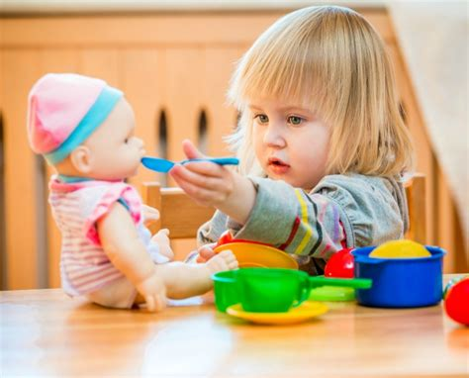




SOCIAL SEMIOTICS

Slide 14
SOCIAL SEMIOTICS
Semiotic function
When a child engages in pretend play, the following areas are strengthened
Cognitive skills
Social skills
Self-esteem
Language
Drawing
Motor skills

Slide 15

SOCIAL SEMIOTICS
This is not a pipe

Slide 16
SOCIAL SEMIOTICS
Semiotic function
The semiotic function doesn’t develop suddenly
Thanks to the semiotic function, we have been able to communicate, create meanings and produce culture
Man is a cultural being, creator and bearer of culture

Slide 17
SOCIAL SEMIOTICS
Semiotic function
the ability to create symbols
Semiotic functions
all imaginative and depictive actions of the human mind
are not components of the thought process itself, but rather help represent knowledge

Slide 18
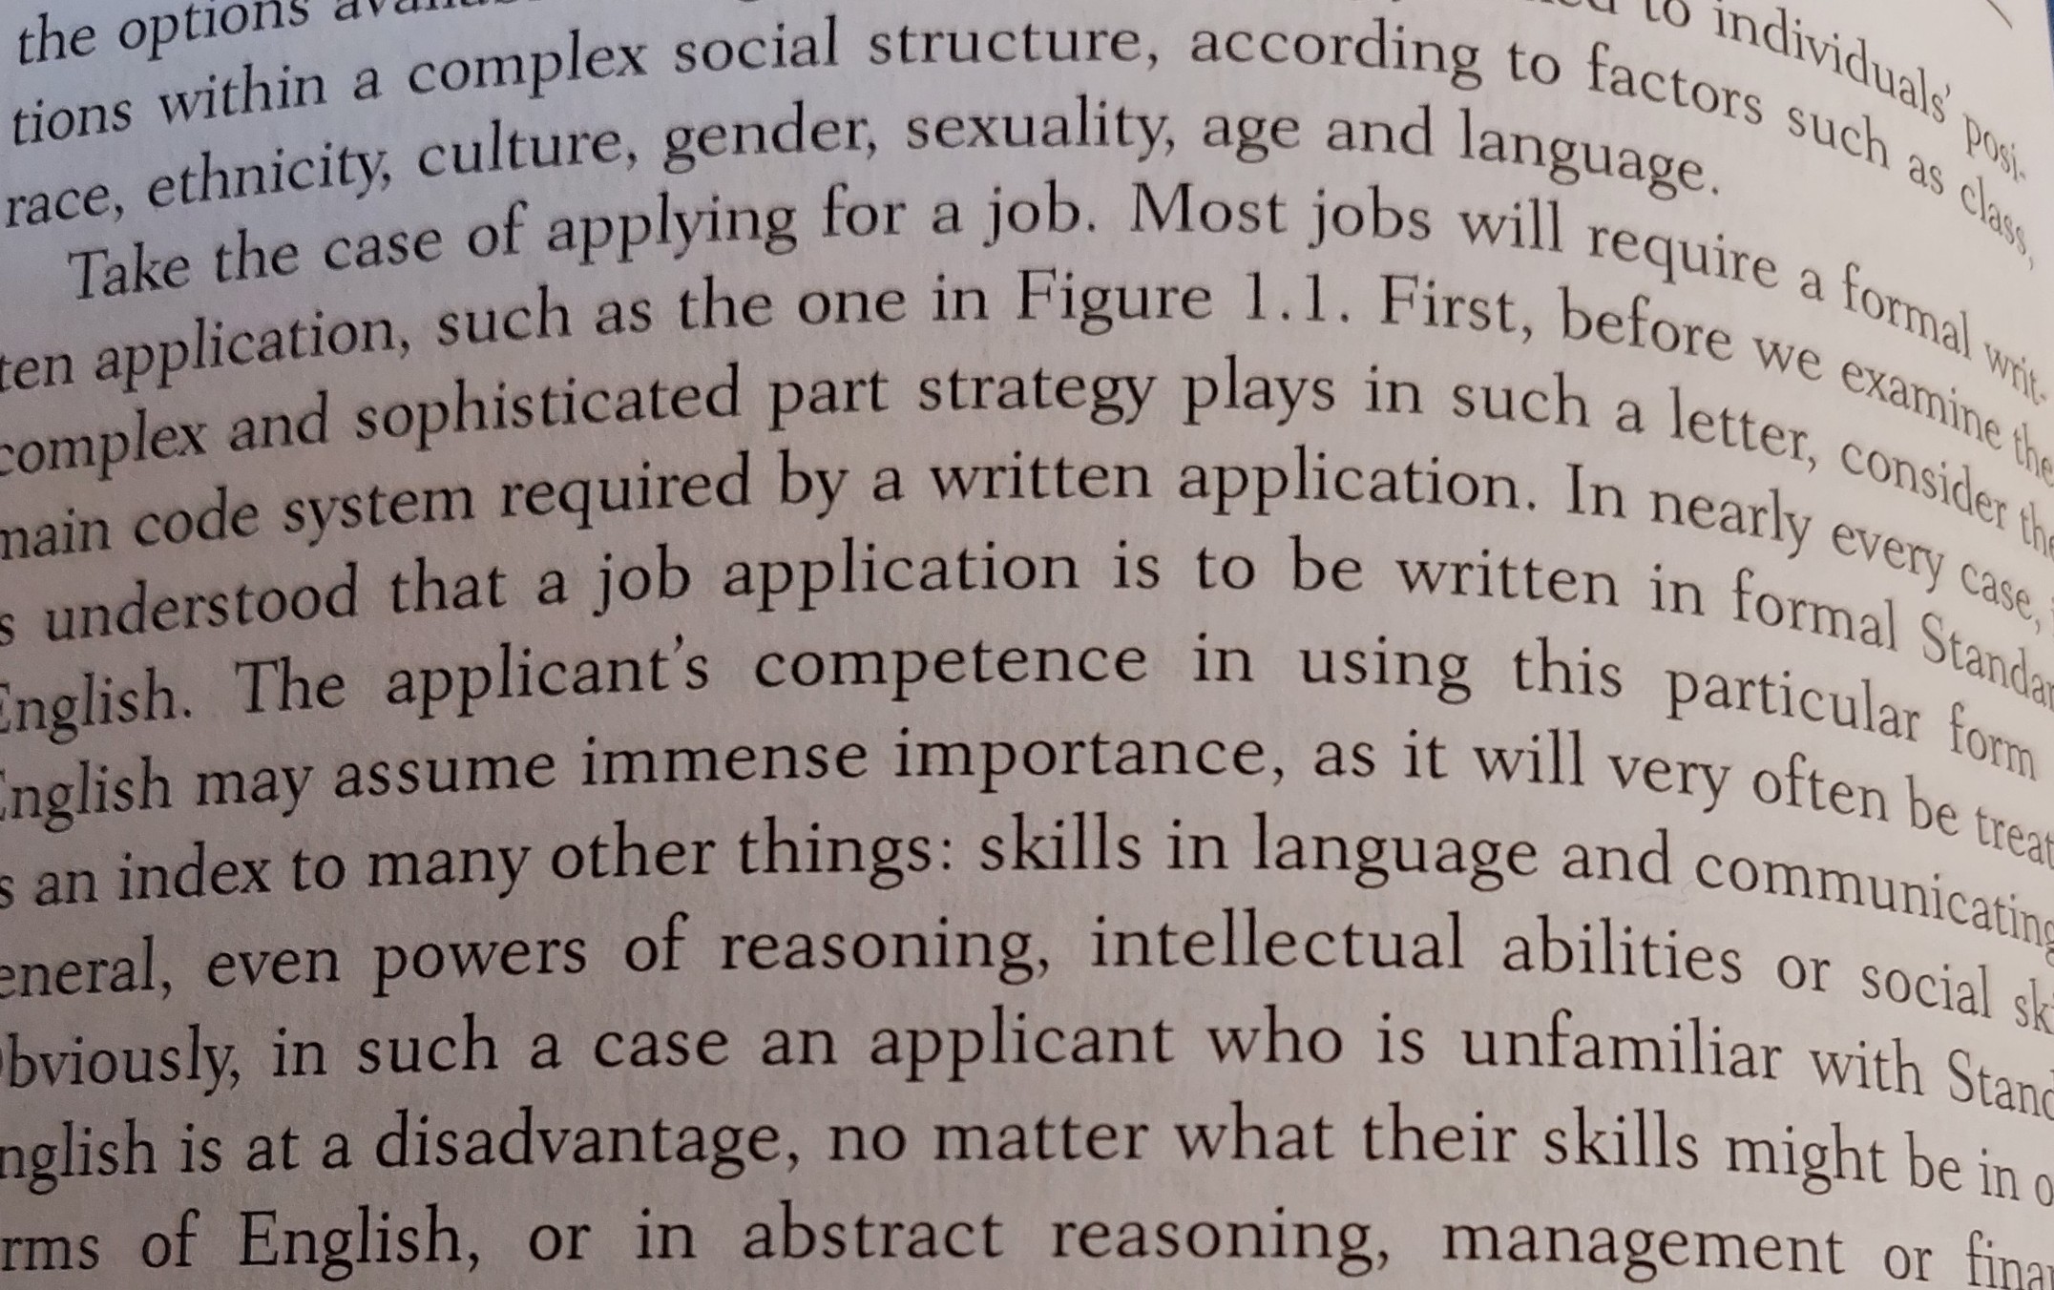


SOCIAL SEMIOTICS
1. The formal function
is tied closely to the material support of the semiotic resources
different supports can produce different sort of formal function

Slide 19
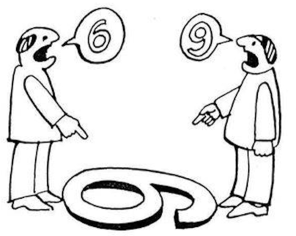



SOCIAL SEMIOTICS
The formal function
as Romans said: Forma dat esse rei!
form helps to give substance to the thing

Slide 20
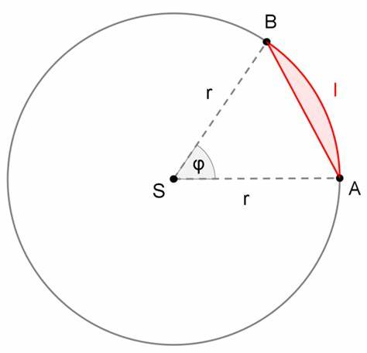





SOCIAL SEMIOTICS
Circle

Slide 21
SOCIAL SEMIOTICS
2. The expressive function
the capacity to construct an addresser
3. The conative function
the capacity to construct an addressee

Slide 22
SOCIAL SEMIOTICS
The sender is the actual source of the message
The addresser of a text is the position it constructs as its source: where it says it is from
The receiver is the actual destination of the message
The addressee of a text is the position it constructs as its destination, where it says it is going

Slide 23
SOCIAL SEMIOTICS
Different senders may share the same addresser
Different receivers may share the same addressee
One sender may produce several different addressers
One receiver may be addressed as a number of different addressee
Sender and receiver are actual people
Addresser and addressee are not people at all

Slide 24
SOCIAL SEMIOTICS
2. The expressive function
the capacity to construct an addresser
3. The conative function
the capacity to construct an addressee

Slide 25
SOCIAL SEMIOTICS
2. The expressive function
the capacity to construct an addresser
is oriented towards the addresser and serving to express feelings or attitudes
Expression can be conveyed using various linguistic elements
Interjections
Using the imperative and subjunctive moods of verbs

Slide 26
SOCIAL SEMIOTICS
2. The expressive function
Examples of the expressive functions are:
Today I feel happy!
What a beautiful sunset!
I like to walk on the beach.
I am very grateful to my family.
Leave me alone!
How long are you going to bother me with your impertinent questions?
I do not care.
Nice to meet you!

Slide 27
SOCIAL SEMIOTICS
3. The conative function
is the capacity to construct an addressee
refers to those aspects of language which aim to create
a certain response in the addressee
We can use different linguistic resources to appeal to the interlocutor
or to call his/her attention
- Verbs are used in the infinitive and imperative mode
- Use of interrogative sentences
- Use of exhortative sentences

Slide 28
SOCIAL SEMIOTICS
3. The conative function
Examples:
Do you have the book which Bob left you?
Could you close the door to the terrace? It starts to get cold here..
Please behave yourself correctly!
Would you like to come with me to Sofia’s birthday party?
Do it now!
Stop immediately!
Can you answer the phone?
Bring us two plates of pasta Bolognese and a bottle of wine, please.
Laura, could you help me with these boxes?

Slide 29
SOCIAL SEMIOTICS
4. The phatic function
the ways in which a social resource constructs a relationship
between addresser and addressee
bind addresser and addressee together in the act of the exchange
of signs
excludes those who are not part of communication
may bind a group together and give it an immediately recognizable
identity, to itself and others

Slide 30
SOCIAL SEMIOTICS
Advertising
is communication
has a specific language structure
contains more than one semiotic resource
is multimodal

Slide 31



SOCIAL SEMIOTICS

Slide 32



SOCIAL SEMIOTICS

Slide 33




SOCIAL SEMIOTICS

Slide 34
SOCIAL SEMIOTICS
5. The metalingual function
is oriented towards the code
suggests the codes by which the semiotic resource
might ne understood
indicates that a sign meaning is far from a given fact

Slide 35
SOCIAL SEMIOTICS
6. The referential function
provide information about certain topics
describes a situation, object or mental state
indicates that a sign meaning is far from a given fact

Slide 36
SOCIAL SEMIOTICS
6. The contextual function
indicate the context in which the sign or social resources operate
The social situation in which a sign or a plurality of signs are used may determine the appropriate content, type of sign and coding, who is being addressed, by whom and how, and the phatic community it constructs

